Slide 1

Choosing cowinding
For 14T magnet

Slide 2
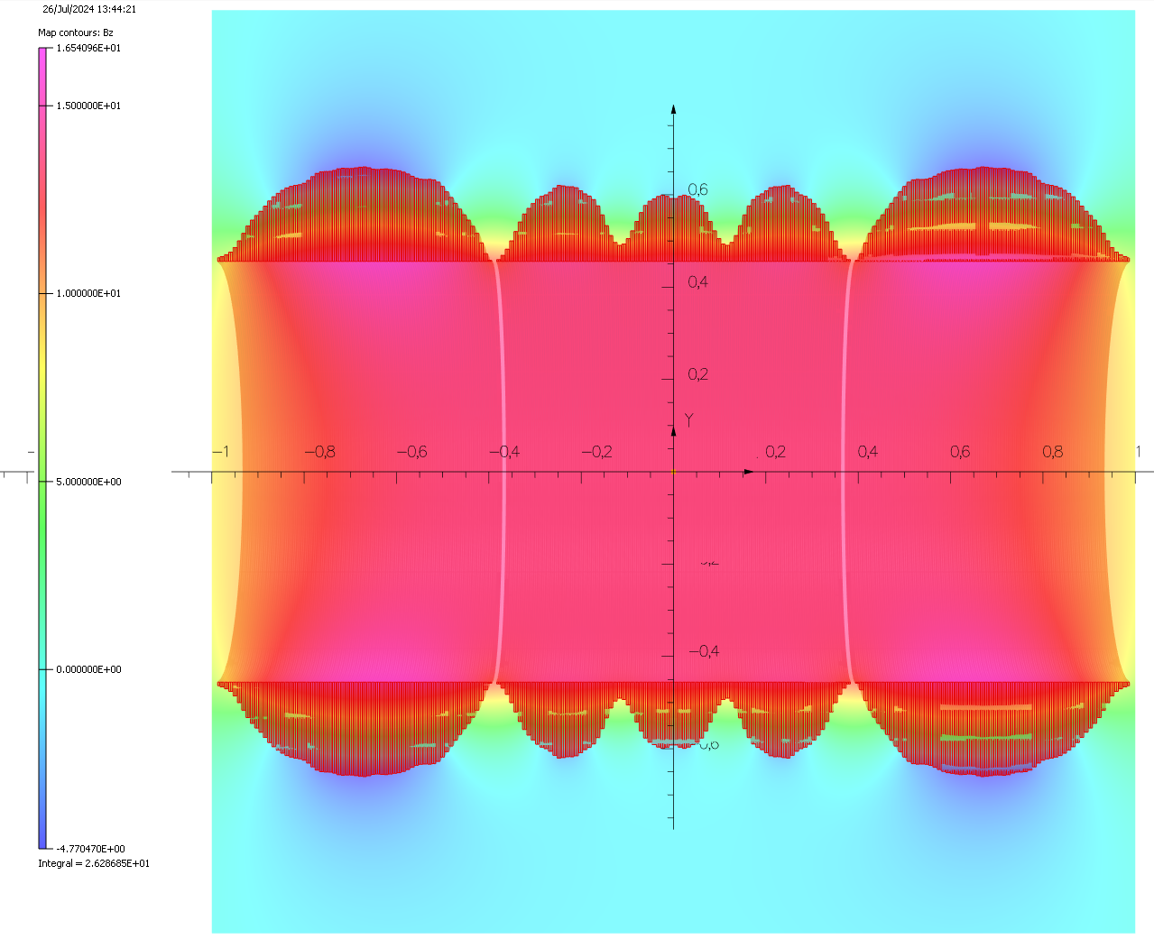
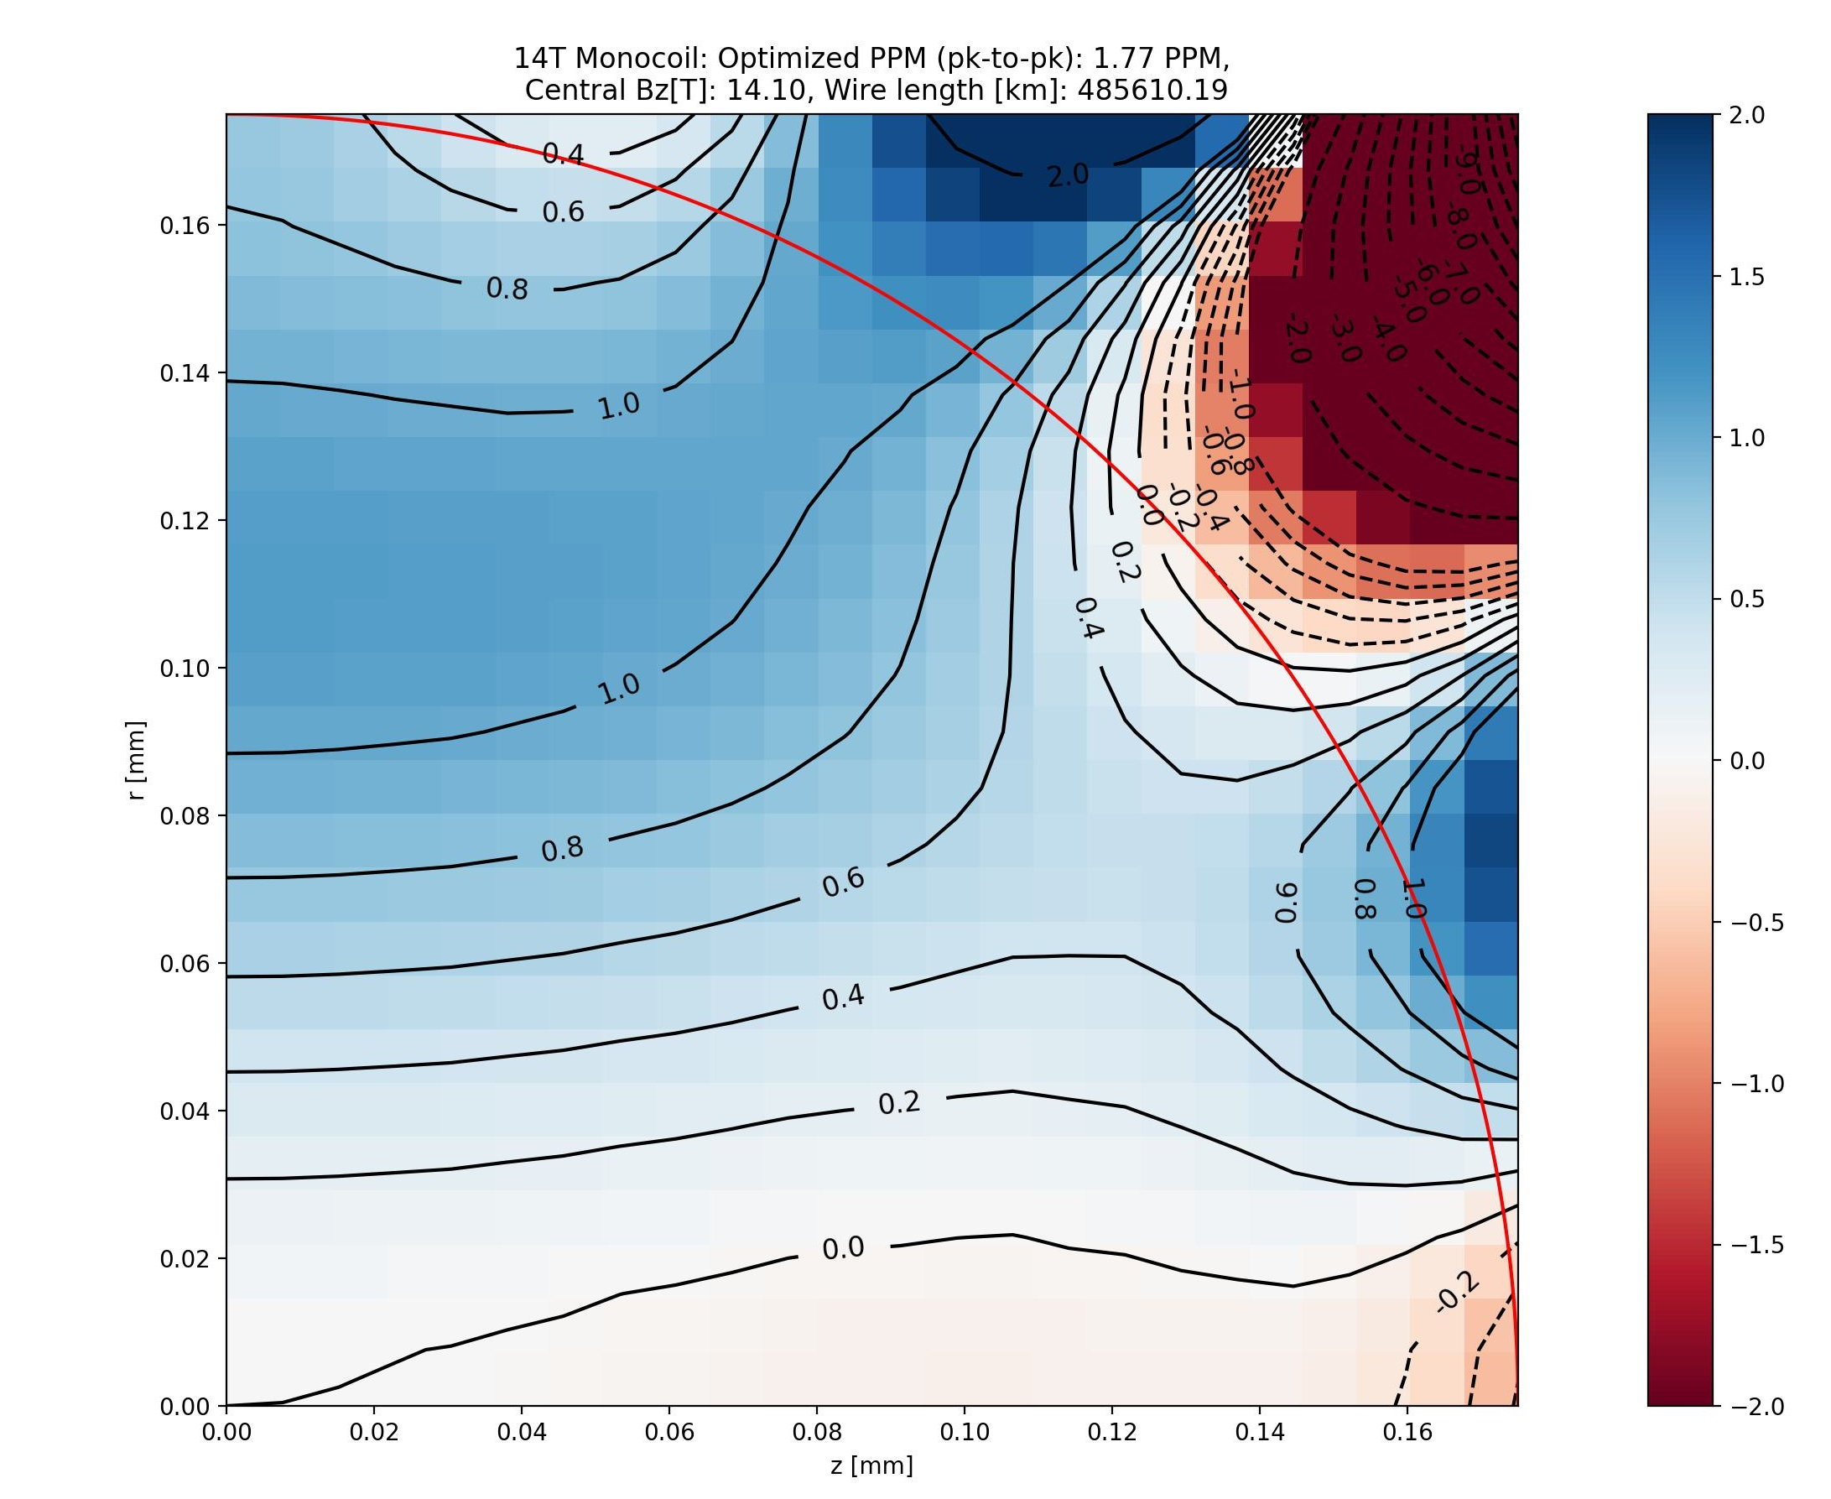
Magnet Design: (genetic+spline from scratch)
Fieldstrength: 14.1T
Wire: 485.6km
Hom. 1.77ppm

Slide 3
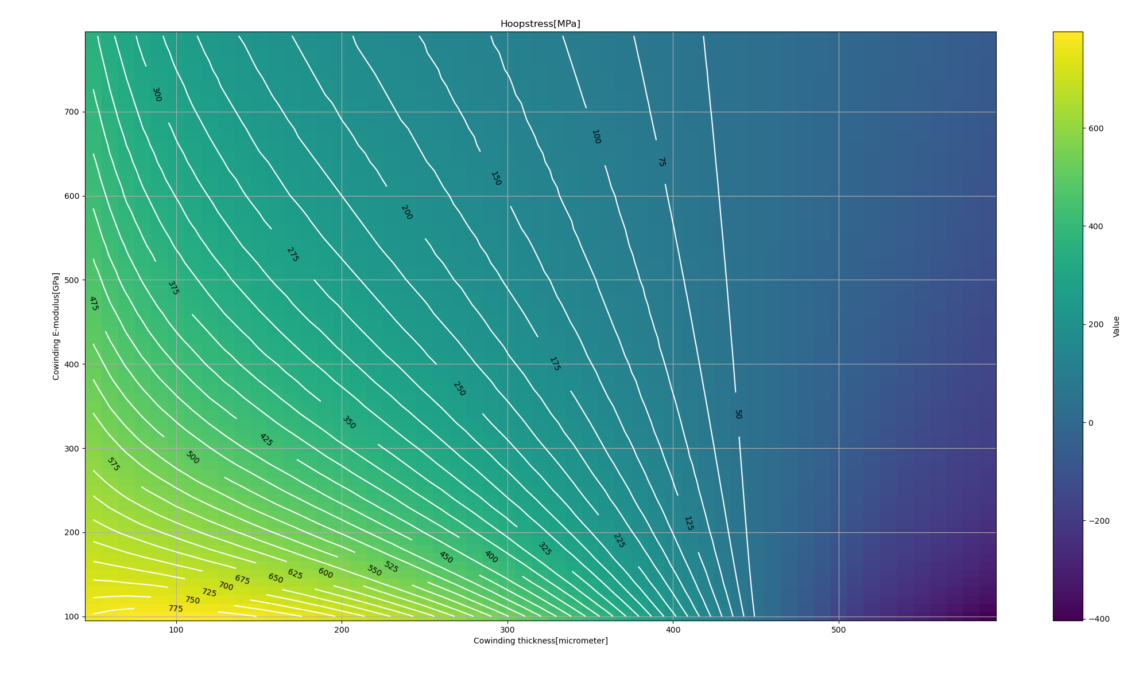
Hoopstress evalution (14T Setup, ~Lis design):

Slide 4
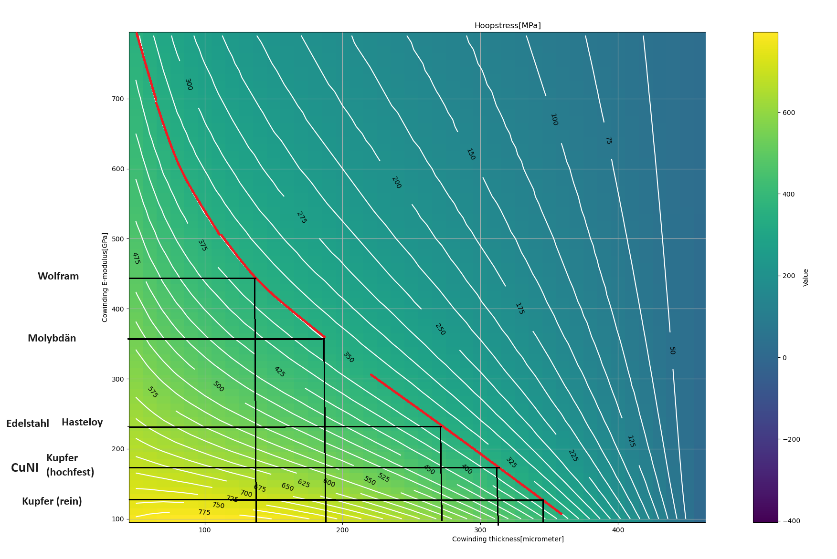
Options for Co-Winding Material
 | E-Modul in Gpa bei 20°C | E-Modul in Gpa bei 8 Kelvin
Molybdän (Mo) = Mo-Band | 329 | 361.9
MoH4-Band
MY-Band
MY-ESS-Band
HASTELLOY® C-276 alloy l NiMo16Cr15W l 2.4819 | 205-215 | 231
Durnomag = 1.4369 = X11CrNiMnN19-8-6 | 200 | 240
Edelstahl z.B. (X5CrNi18-10) - ca. 200-220 GPa | 200-220 | 231
Kupferlegierung hochfest CuMn20Ni20 | 160 - 180 | 187
CuNi C71500 | 150 | 160 bei 4 K
reines Kupfer = 2.0060 = Cu-ETP | 110 - 130 | ~130
Wolfram | 405 | 445.5

Slide 5
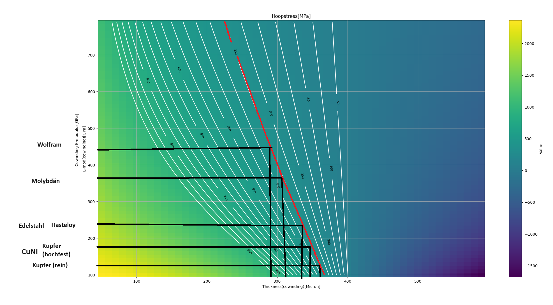
Fresh result: Hoopstress simulation for our 14T settings:

Slide 6
Path to final magnet design:
14T Magnet Design
Optim. Homogeneity and Wire consumption
Estimate Stresses
For Axial and Hoopstresses
Acoount for stresses
Incorporate cowinding (radial distriubution and material type)
Incorporate pressure disk distribution along z axis
Second optimization
Regain 14.1T & 1ppm homogeneity

Slide 7
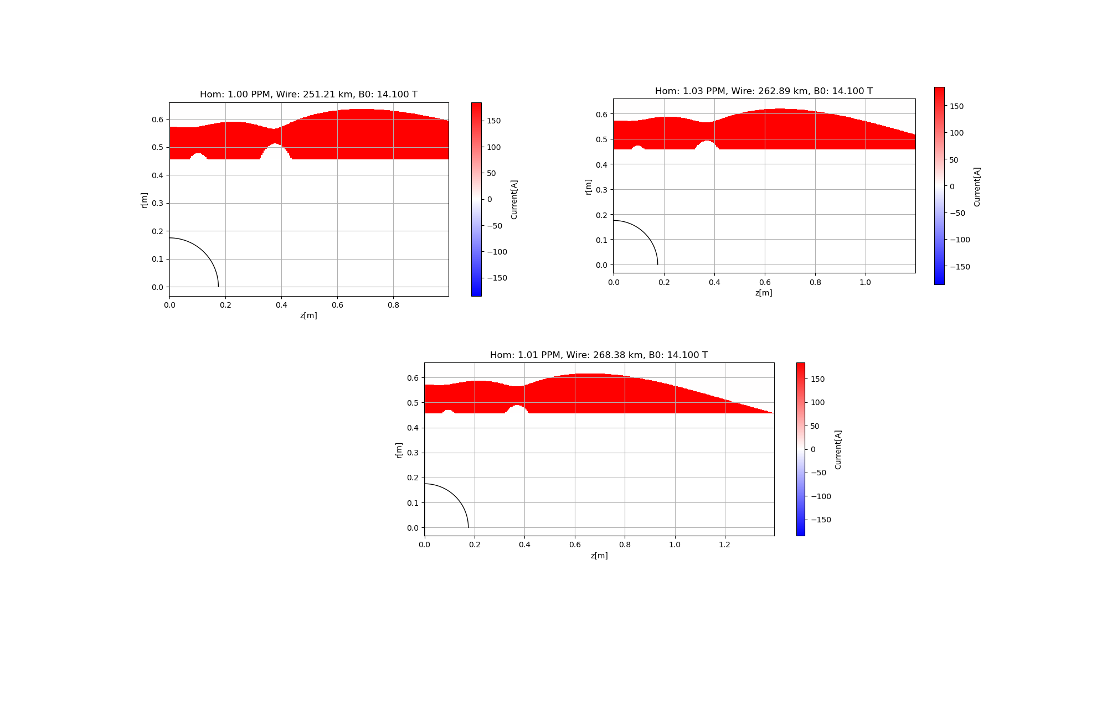
Magnet Design: (linear solver, global solution)
*2
*2
*2

